Slide 1
Tenden Bicycle
Greedy Algorithms
23/07/05

Slide 2
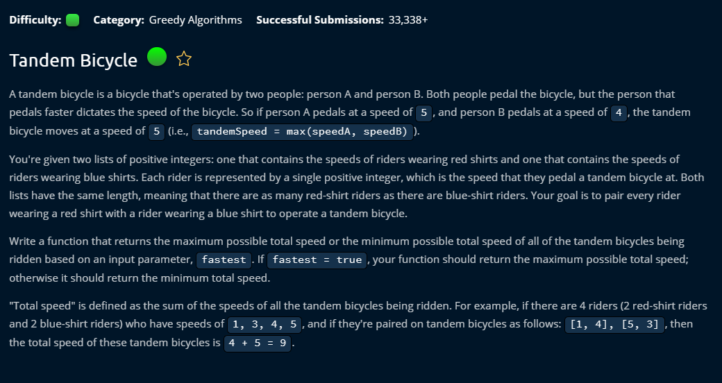

Slide 3
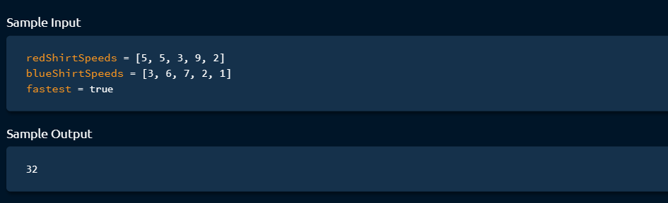

Slide 4
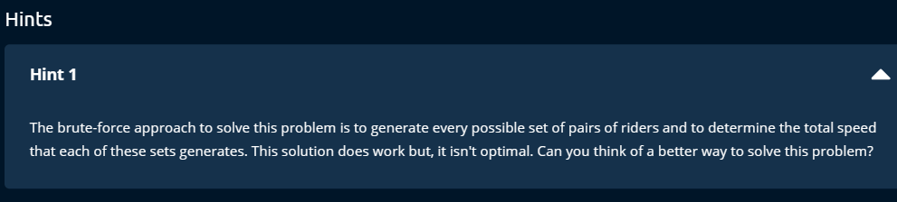

Slide 5
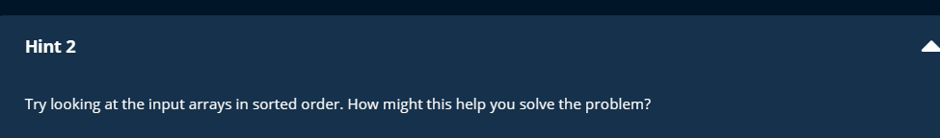

Slide 6
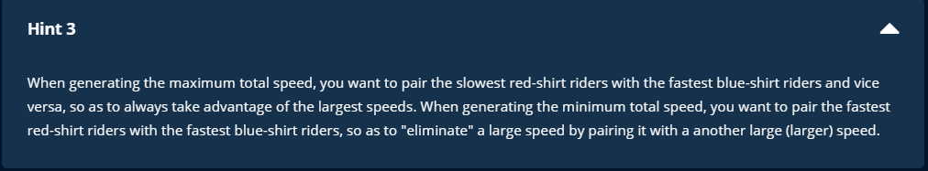

Slide 7
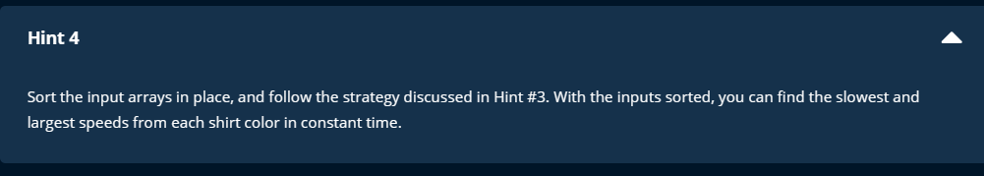

Slide 8
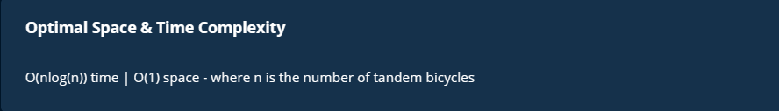

Slide 9
Steps
for max speed, find the max between two oppositely sorted array
for min speed, find the max between two array that are sorted in same direction.
Note:
Don't try to find the min of the two oppsitely sortd array. Tenden takes the max speed.

Slide 10
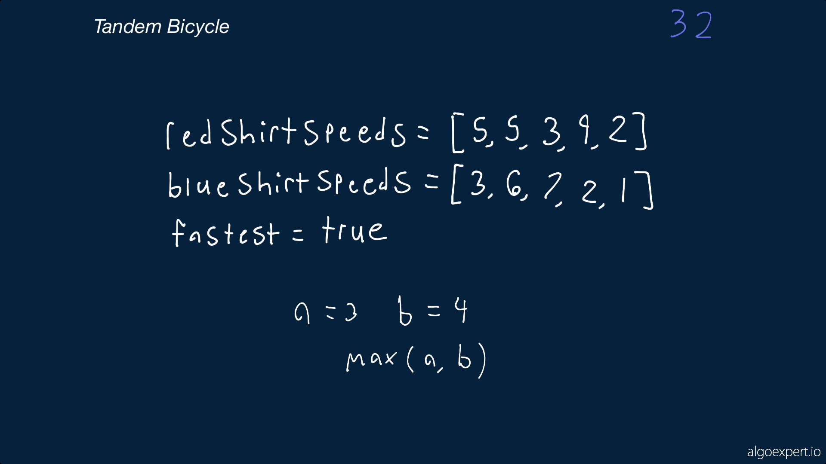

Slide 11
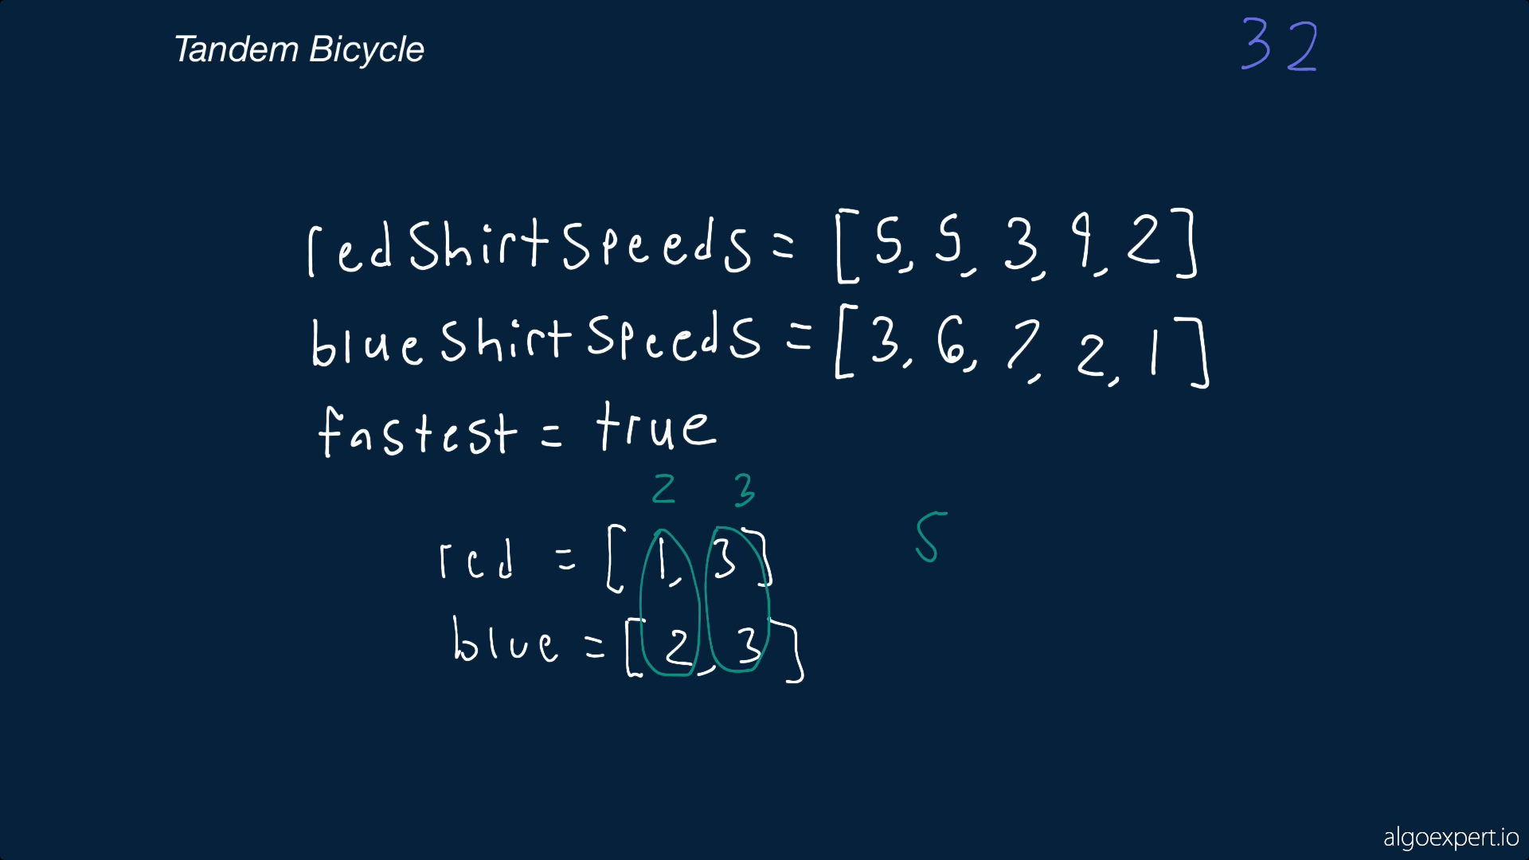

Slide 12
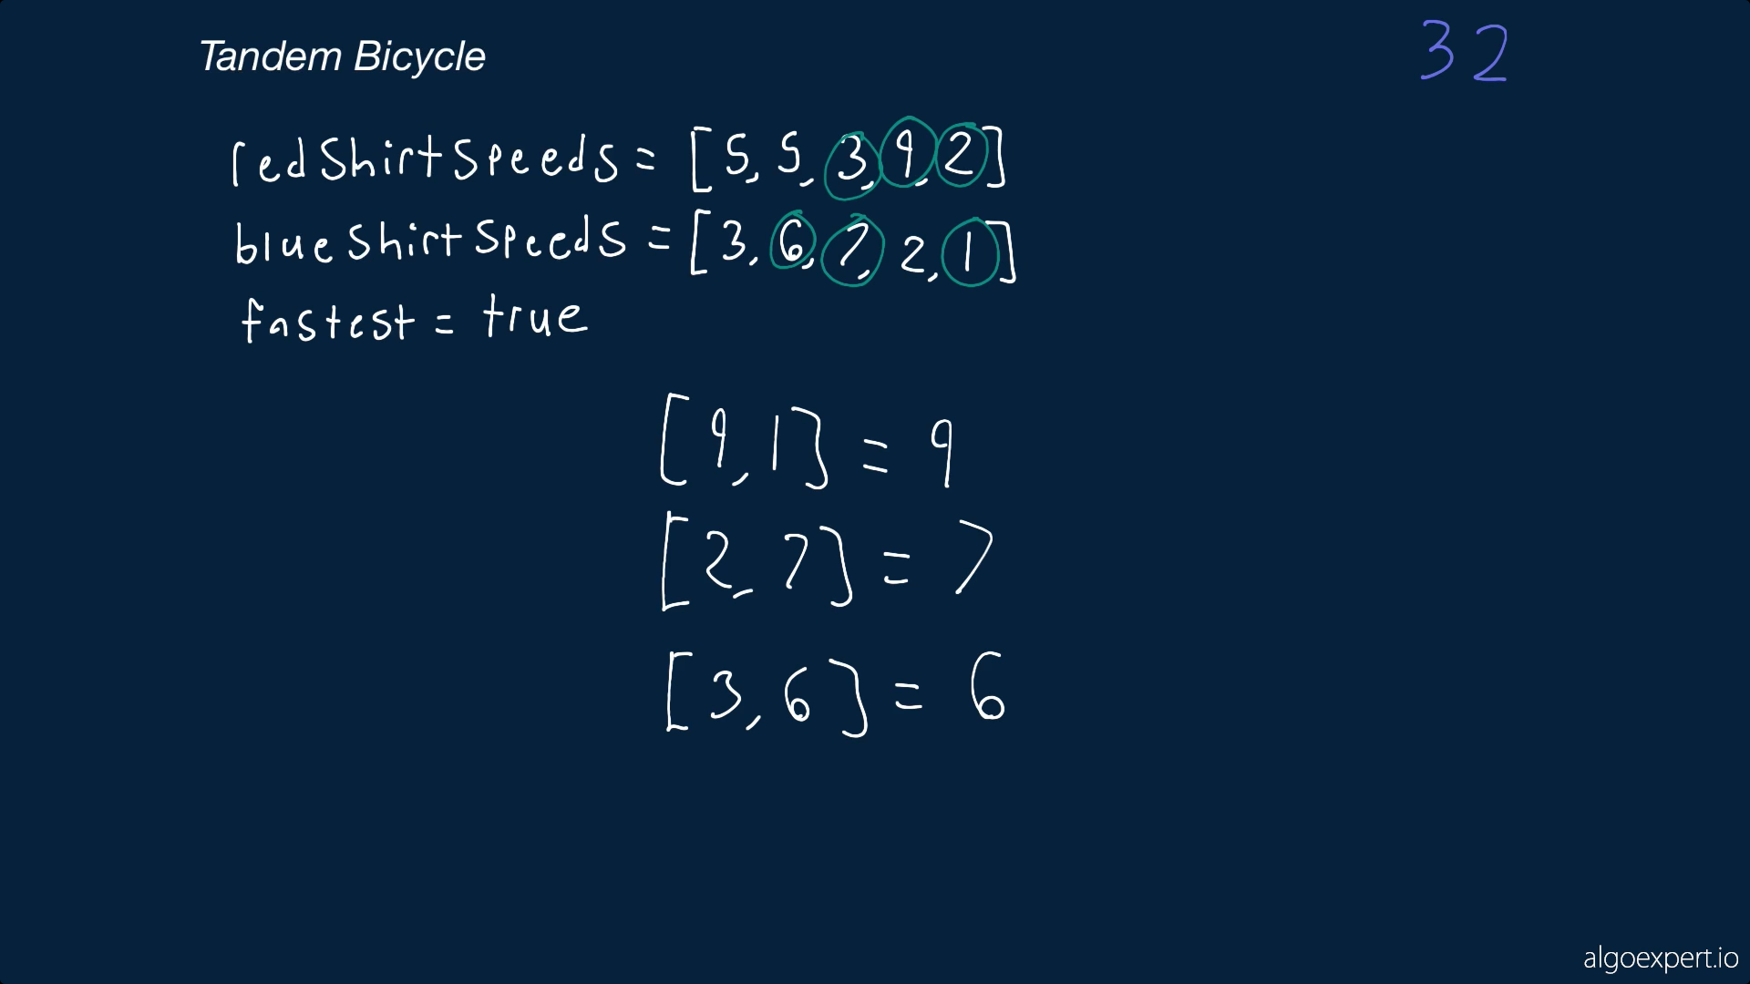

Slide 13
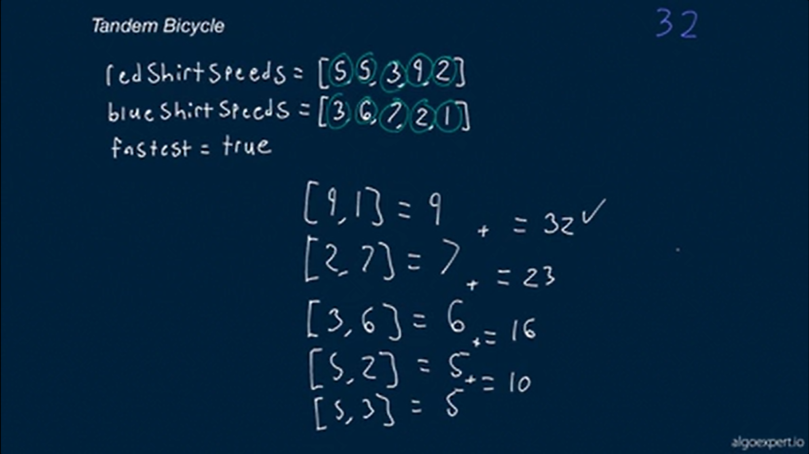

Slide 14
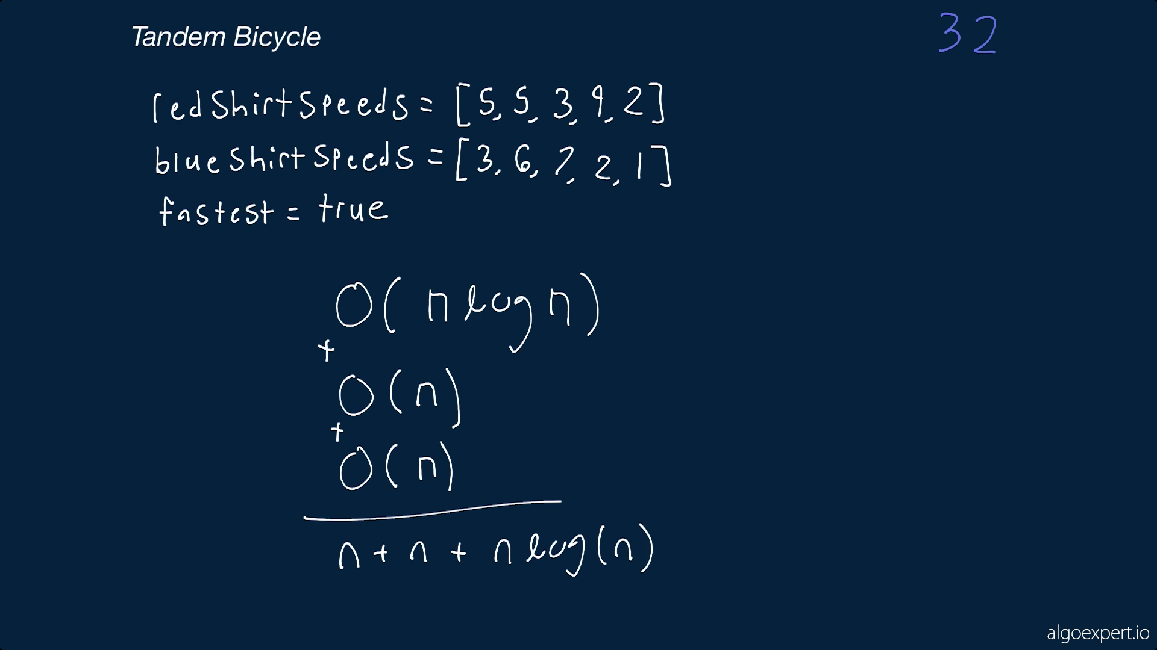

Slide 15
